Slide 1
Vitang
Leading Digital Dentistry
Innovative Dental Service Based on Cutting Edge Digital Technologies

Slide 2
Who Are We?
What Is Happening Out There?
What Can We Do?
How Can We Do It?
When Can We Achieve It?

Slide 3
Who Are We?-- Company History
Founded in Tustin, beautiful Orange County, California, since 2014, Vitang Technology was a Photosensitive Resin manufacturer. Our resin was sold globally matching many DLP and SLA printers such as Real Maker, Flashforge, Dental One, etc. The R&D in the past years provides us precious experience about how does 3D printing technology apply in dental field.

Slide 4
Who Are We?-- Our Team
Ron Jiang
CEO and investor, was a leader in Medical Devices manufacture field, especially in Zirconia.
Over 20 years experience guides us in this niche but technology intensive market.
Sean Chen
Chief Technical Officer
12 years in dental industry, inventor of many dental products with total sales of more than $50 millions.
Tom Wang
VP and sales manager.
2010 to 2015, Tom was a sales person in financial field. Top 10 sales in Hana Bank of 2014.
Shawn Shao
Product Engineer, Master of Science in Product Development Engineering from USC.
Ye Tian
Product assistant, Master of Science in Mechanical Engineering from Texas A&M

Slide 5
What Is Happening Out There?--US Dental Market
~ $150 Billion in total size
~ 150,000 dentists
120,000 general dentists
30,000 specialists: endodontists, orthodontists, periodontists, oral surgeons
400,000 dental hygienists, assistants, dental lab technicians
Fastest growing segments: specialty market
Implants, $10 Billion in a 5 years.
Orthodontics
Endodontics
Dental laboratories
~ $6 Billion in US

Slide 6
What Is Happening Out There?-- Technology Trends in Dentistry
Digital Dentistry
Clinical CAD/CAM
10% market share
Intraoral scanning
Crown milling
Laboratory
fast growing
3D model imaging
Crown and bridge designs and productions
Delicate designs and fabrications
3D models and surgical supporting devices
Orthodontics

Slide 7
What Can We Do?--Vitang’s Missions
Using cutting edge digital technologies to provide faster, more esthetics and more reliable dental services.
Three directions:
Orthodontics: clear aligners and traditional
Crowns and veneers
Supporting surgical units

Slide 8
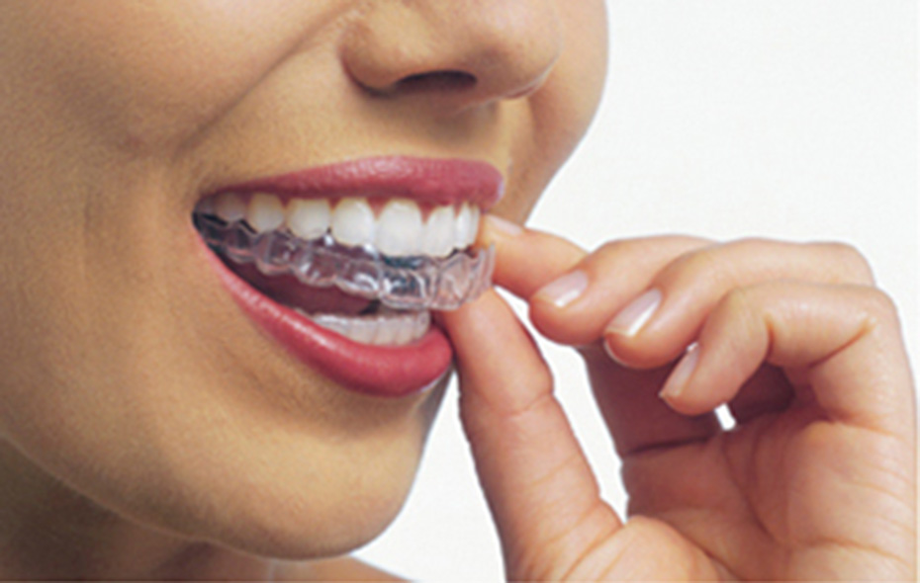
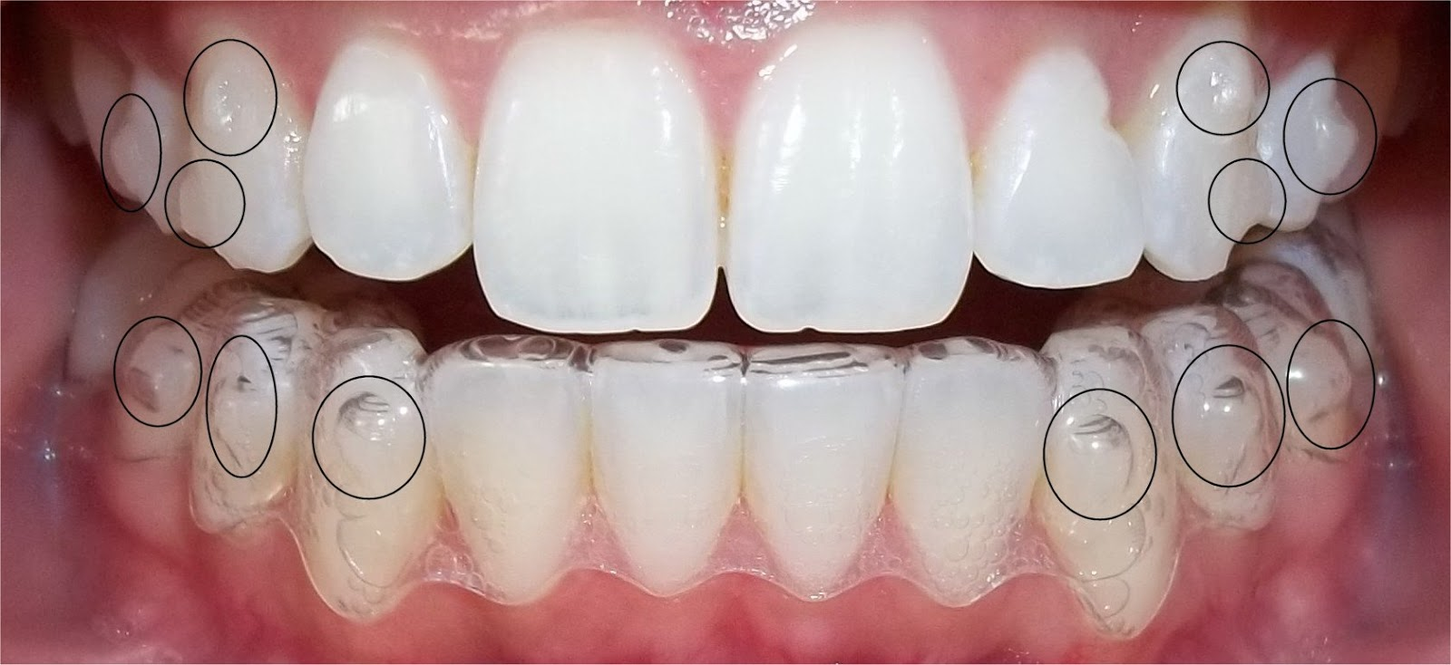
What Can We Do?-- Orthodontics: clear aligners
Fast growing
~$2 Billion market in US
Technology is ready to go
Marketing targets: general dentists

Slide 9
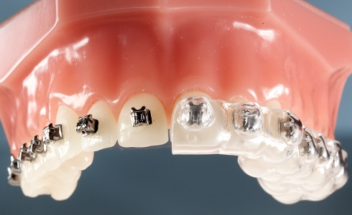
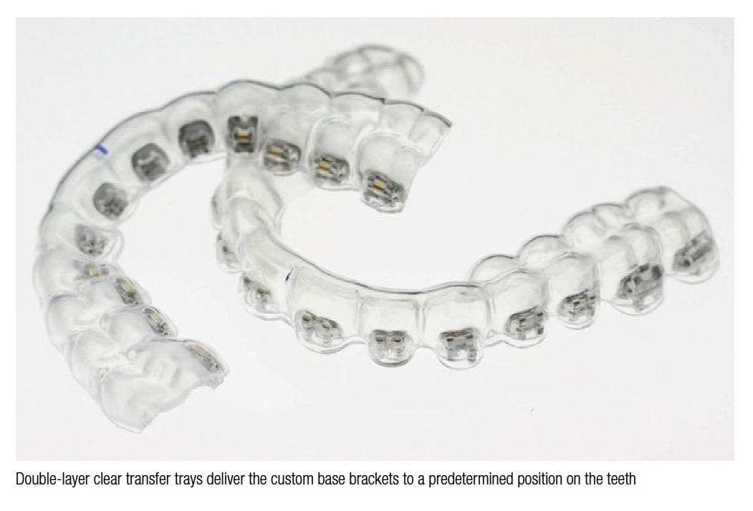
What Can We Do?-- Traditional Orthodontics
Helping general dentists or orthodontists to quickly align metal brackets
The first in the market

Slide 10
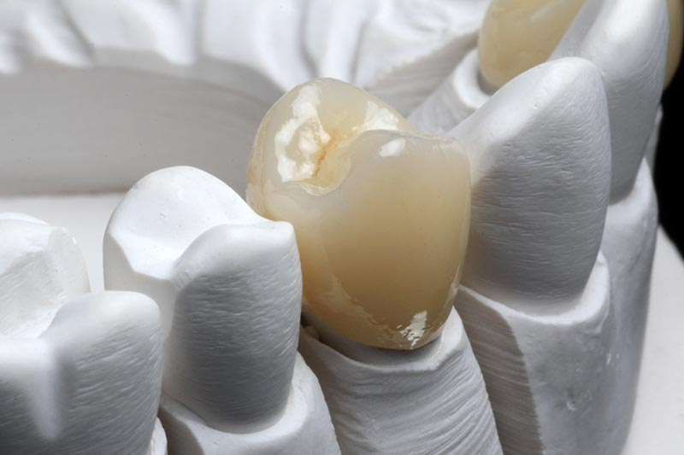
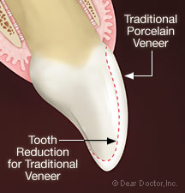
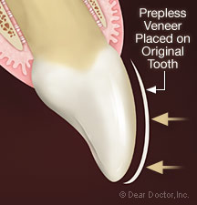
What Can We Do?-- Crowns and Veneers
3D design and fabrication
Quicker turn-around than traditional
Better fitting and longevity than milling
Cutting Edge Design

Slide 11
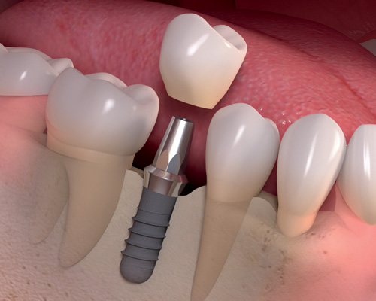
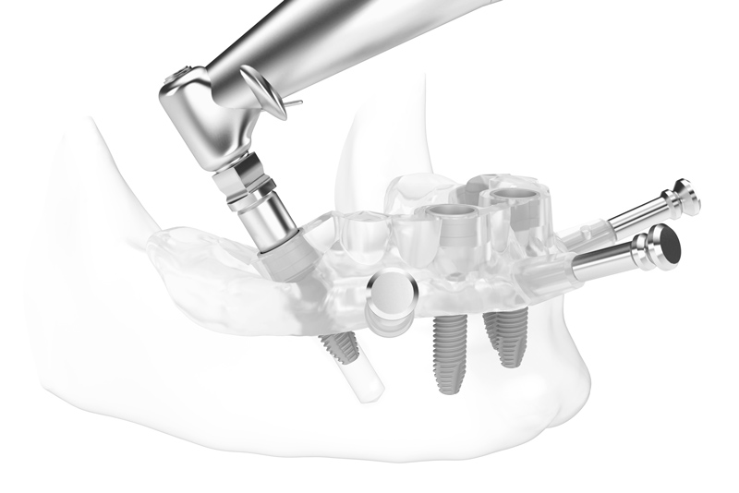
What Can We Do?-- Supportive surgical devices
3D design and fabrication
Help general dentists to perform implant procedures

Slide 12
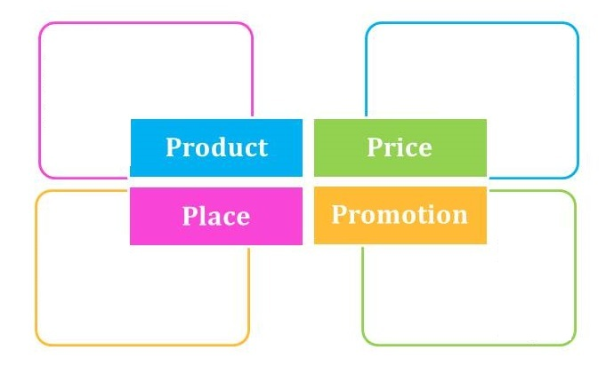
How Can We Do It?--Marketing 4Ps Analysis
Design and/or 3D printing
--Crown and Bridge
--Surgical Guide
--Aligners
--Sleeping Devices
--Model
--Others
Stable Margin--
Quality and Service Sensitive--
Overall Low Cost--
Technology Barrier--
70% of Gross Margin--
--B2B
--B2C
--Online Marketing
--Shows and Fairs
--Door to Door
Dental Education--
Push Marketing--
Search Engines--
Personal Selling--
Discounts with Referrals--

Slide 13
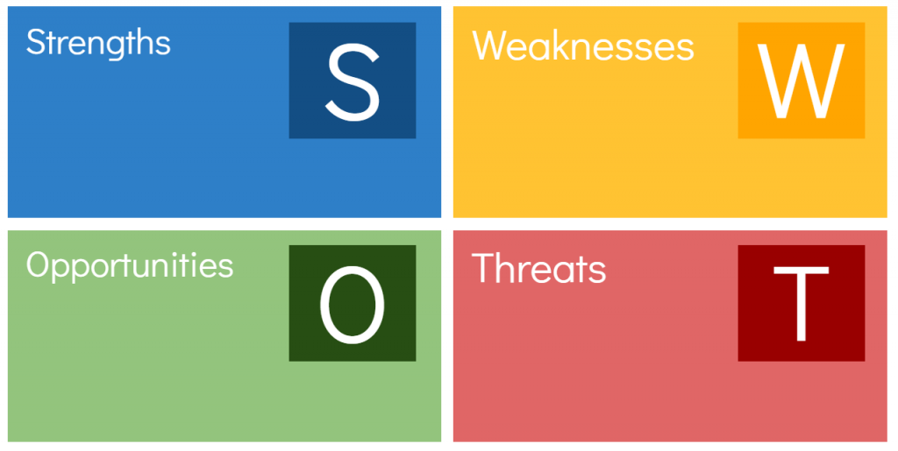
The First Movers
Understanding of 3D Printing
High Customization
Fast Turnaround Time
High Quality
Digitalized
Capital
Sales Force
Customer Pool
Trend of Digitalization
Customization
More Refined Division of Labor
Trend of direct sale
Big Players Enter
New Gene Cure
Dentists Based Tech Eliminates Labs
Others

Slide 14
When Can We Achieve It?-- Present and Future
Current clients are local based. Such as Itec Dental Lab, Spectrum Dental Lab, Deton Dental Lab, etc
We expect to achieve $2 M sales in the first 2 years.
$10 M to $15 M in 5 years.
More capacity and employees, website upgrade as well, needed.

Slide 15
Who Are We?-- Vitang Technology based in Tustin, CA.
Professional and stable team.
What Is Happening Out There?-- Huge and fast growing market.
The tendency is more technology based.
What Can We Do?-- Design and manufacture orthodontics devices such as clear aligners, crowns and veneers as well, and supporting surgical units, such as surgical guide, etc.
How Can We Do It-- Channels and marketing tools are available.
When Can We Achieve It?-- We are already in marketing stage now and we expect $2 M in 2 years and $10M to $15M in 5 years.

Slide 16
Thanks!
Any Questions?
Contact us by email:
info@vitangtechnology.com

