Slide 1
SABPA 7th Career Development Event
Stephen Zhou
Oct 28, 2017
Irvine

Slide 2
SABPA 7th Career Development – A Personal Experience
Contents
Self Introduction
Career Development: Self-Development
Personal Experience
In Large Companies
In Start-up Companies

Slide 3
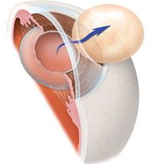
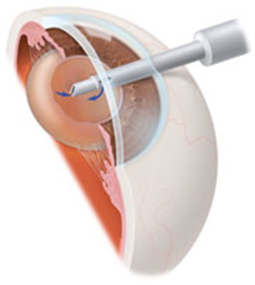
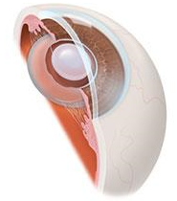
SABPA 7th Career Development – A Personal Experience
Introduction – Cataract Surgery and Intraocular lens
Incision size 9 mm about 2 mm Intraocular lens inside eye
R&D in Biomaterial/Intraocular lens for cataract surgery (1990 – 2017)

Slide 4
SABPA 7th Career Development – A Personal Experience

Slide 5
What is the most important factor in Career Advancement?
SABPA 7th Career Development – A Personal Experience
University
Degree
First Job
Or 2nd Job

Slide 6
SABPA 7th Career Development – A Personal Experience
Answer: It is You!
How You deal with customer and colleagues
So, Career Development is Self-Development

Slide 7
SABPA 7th Career Development – A Personal Experience

Slide 8
SABPA 7th Career Development – A Personal Experience
Your relationship with
Boss
Peers
Subordinate
Yourself

Slide 9
SABPA 7th Career Development – A Personal Experience
Yourself
Your career goal: technical, managerial, both?
Be positive and confident
Set priorities
Take calculated risks
Communication skills
Always be prepared, be adaptive (Proactive)
Commitment vs royalty (Sharpen your saw)
Be persistent

Slide 10
SABPA 7th Career Development – A Personal Experience
Boss: (Seek first to understand)
Understand what is his/her role
Understand what is your role
Never ask a question you should answer by yourself
Propose your solutions and ask your boss to support you
Chain of command

Slide 11
SABPA 7th Career Development – A Personal Experience
Boss (then to be understood):
Be brief, to the point, your boss is a busy guy
Keep your timeline, inform your boss of any unexpected delays. Give your boss the impression that you are a problem solver
Be a good negotiator, set reasonable expectations, be upfront
Keep a professional relationship with your boss; no/little personal relationship is just fine

Slide 12
SABPA 7th Career Development – A Personal Experience
Peers (win-win)
Understand your peer’s responsibility and boundary
Have a regular meeting schedule
Be supportive and ask for support in return
Create a win-win situation
Occasionally need to manipulate
Fight is your last resort
Say Thanks

Slide 13
SABPA 7th Career Development – A Personal Experience
Subordinates
Be a leader
give them credits and spotlight
Take total responsibility when things go south
Promote them or give them a big raise for excellent jobs
Don’t simply tell them what to do. Tell them what your goal and requirements.
Encourage them to develop a plan for themselves, have them commit to it, hold them responsible for the plan
Reward good performers and discourage bad behaviors
Say a lot of thanks

Slide 14
SABPA 7th Career Development – A Personal Experience
Start-up
Innovative Technology
Billion dollar market potential
Patentable exclusive technology/product
Clinically proven (outside USA)
Leader’s Vision (Philosophy)
Vision
Exit strategy
Know when to abandon the ship but never burn bridge
When CEO’s vision collides with yours
My lessons: you controls the company; or your partner is a proven leader

Slide 15
SABPA 7th Career Development – A Personal Experience
Thank you

